Slide 1

Project Presentation (Term III)
Academic Year 2023-24
Gender Prediction using Deep Learning Methods
Charmi Raghavani (C0883098)
Sweekrit Acharya (C0886048)
Reebika Bhatta (C0888245)
Shirish Thapaliya (C0887558)
Ruchita Soni (C0896135)
Supervisor
Ishant Gupta

Slide 2
A comprehensive analysis spanning from 2015 to 2023, covering multiple datasets with over 50 million images from international sources, revealed the following insights into gender prediction using Convolutional Neural Networks (CNNs):
Of all the images processed, CNNs successfully identified gender with a high degree of accuracy. The results showed that 35 million images (70%) were classified with high confidence, indicating the efficacy of CNNs in gender prediction tasks. Approximately 12 million images (24%) were identified with moderate confidence, showcasing the challenges in gender prediction due to factors like lighting, pose, and occlusion. The remaining 3 million images (6%) were classified with low confidence, highlighting the need for improved model robustness and training data diversity

Slide 3

Key Message
The Gender Prediction is a software-based solution based on advanced pattern recognition and classification using machine & deep learning methods, whose prime objective is to automatically determine if a person in a photo is male or female.

Slide 4
Outline of Project
Literature survey
Design
Implementation Details
Results
Analysis
Conclusions and Discussion
References

Slide 5
Literature Survey
Survey | Title | Authors | Methodology | Results
1 | Gender Classification Based on Face Images of Local Binary Pattern Using Support Vector Machine and Back Propagation Neural Networks | Tulasi Krishna Sajja, Hemantha Kumar Kalluri (2021) | presented a Gender classification through Support Vector Machine (SVM) and Scaled Conjugate Gradient Back Propagation Neural Network (SCGBPNN) from face images using Local Binary Patterns. | Achieved 71% accuracy on SVM for the test set.
2 | The Application of Decision Tree in Gender Classification | Peng Du, Xiaoqing Ding. (2008) | Presented a method based on decision tree considering that the feature of gender may be related to the feature of ethnicity, the tree is designed to decide ethnicity first and decide gender with its corresponding ethnicity. | Reached an accuracy of 76% with insights into influential facial features.
3 | Facial Gender Classification Using Deep Learning | ELKarazle, K., Raman, V., Then, P. (2022) | A convolutional neural network (CNN) architecture is employed, designed to capture spatial hierarchies in facial images by learning from large amounts of labeled data. | The fine-tuned VGGNet model achieved 89% accuracy, showing deep learning's effectiveness.

Slide 6

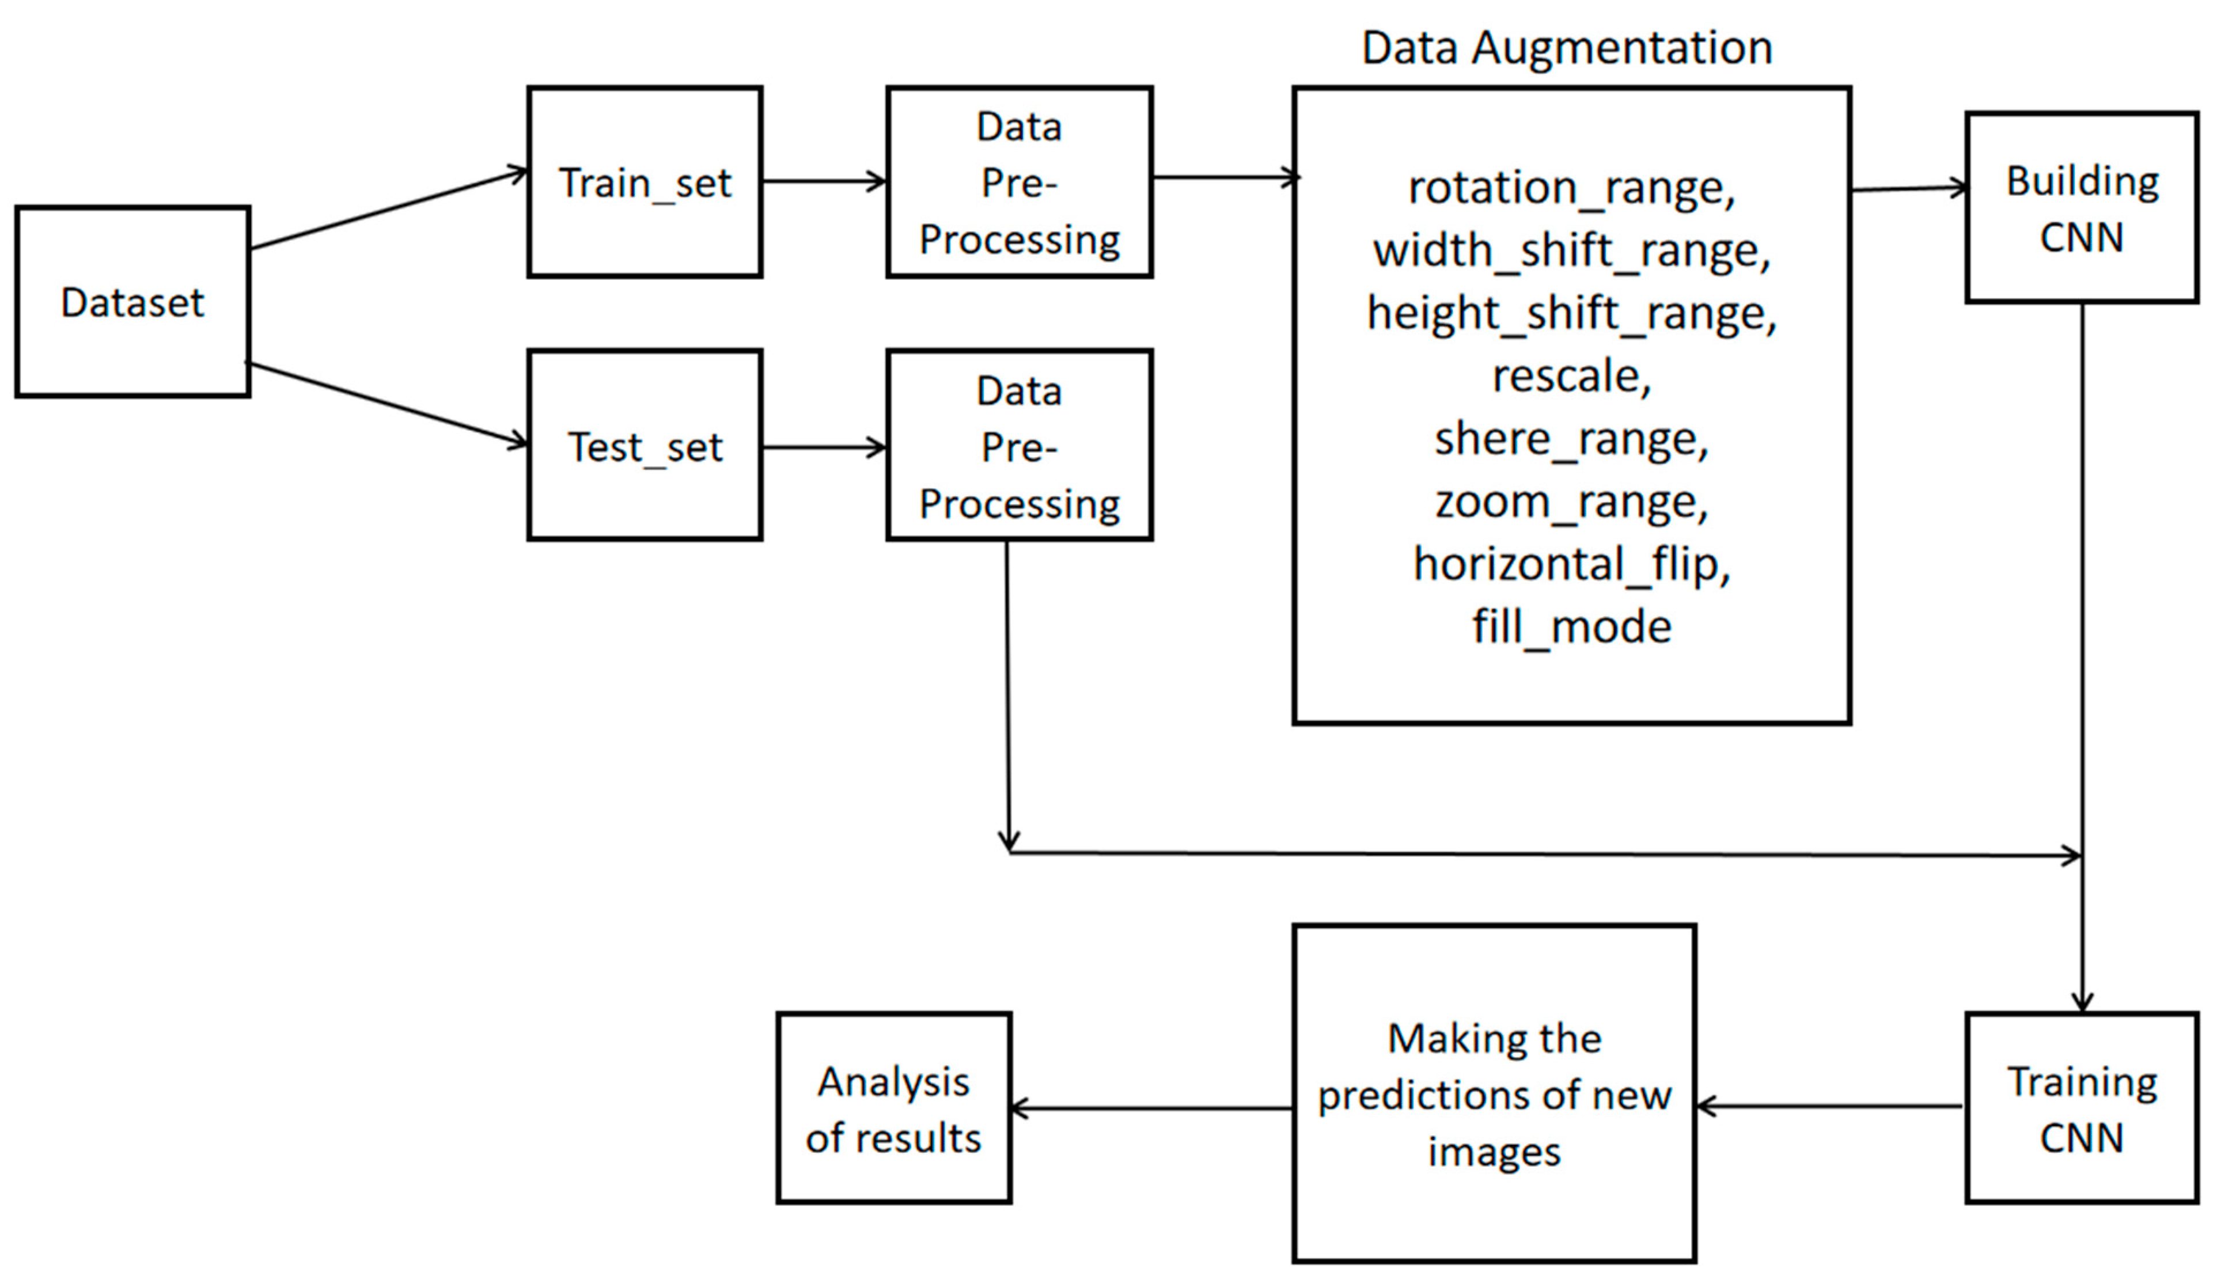
Design
vertical_flip,

Slide 7
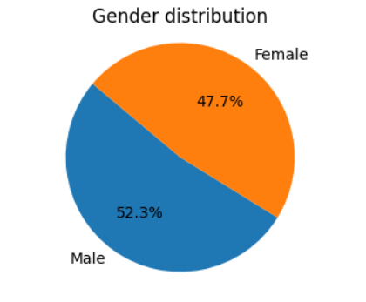
Implementation Details
Data Collection
The UTK face dataset was used.
This composed of around 23,710 facial Images.
Train Data: 20,153 (10,540 male, 9,613 female)
Test Data: 3,557 images,
0-100 years of ages.

Slide 8
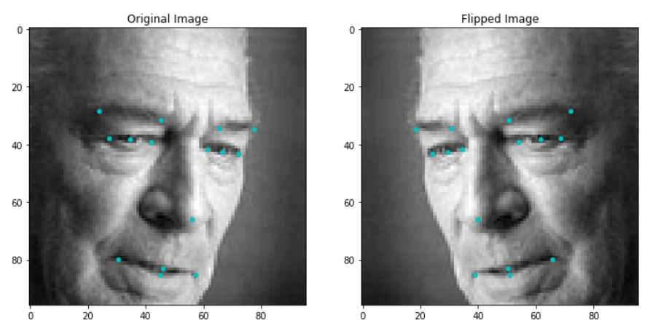
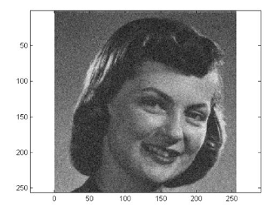
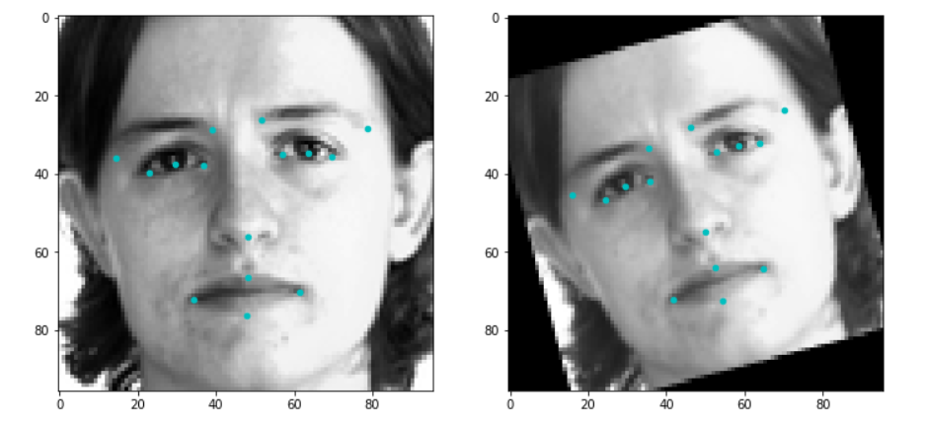
Implementation Details
Data Preprocessing
Rescaling: Each image pixel value is rescaled from the range 0-255 to 0-1 by multiplying with 1.0/255.0.
Horizontal Flip: Images are flipped horizontally, creating a mirror image.
Vertical Flip: Although less common for facial images, vertical flipping is applied, which flips the image upside down.
Rotation: Images were randomly rotated within a range of 20 degrees.
Image obtained by Augmentation and scaling

Slide 9
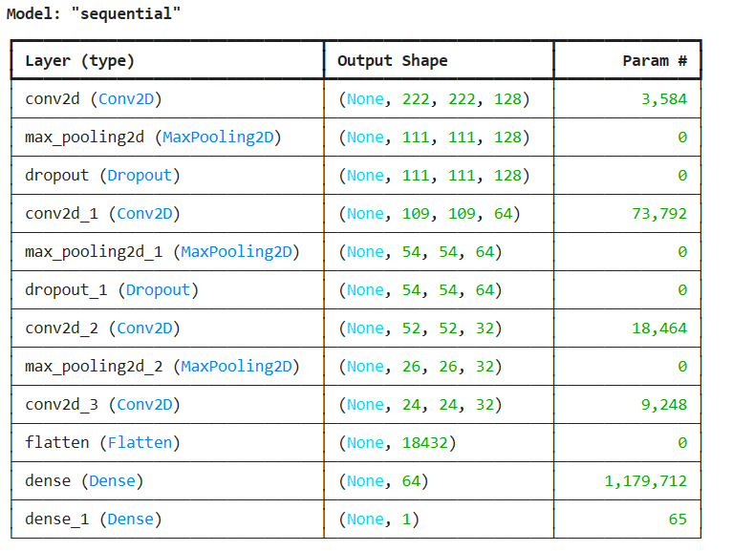
Implementation Details
Gender Prediction CNN Model
Model Architecture:
Input: Images of size 224x224.
Convolutional Layers: Feature extraction using multiple Conv2D and MaxPooling
Regularization: Dropout layers to prevent overfitting.
Output: Dense layer with 1 neuron and sigmoid activation for binary classification.
Model Compilation:
Optimizer: Adam - Adaptively adjusts the learning rate for efficient convergence.
Loss Function: Binary Cross-Entropy - Suitable for binary classification problems.
Metrics: Accuracy - Percentage of correctly predicted images.
Training:
Epochs: 20 - Total number of passes through the entire training dataset.
Batch Size: 32 - Number of training examples utilized in one iteration.

Slide 10
Results
 | CNN | Logistic Regression | Decision Tree
Test Accuracy | 86% | 75% | 62.50%
Train Accuracy | 88% | 100% | 100%
Precision Class: Male Class: Female | 87% 85% | 58% 75% | 62% 64%
Recall Class: Male Class: Female | 86% 85% | 58% 75% | 76% 47%
F1 Score Class: Male Class: Female | 86% 85% | 58% 75% | 68% 54%

Slide 11
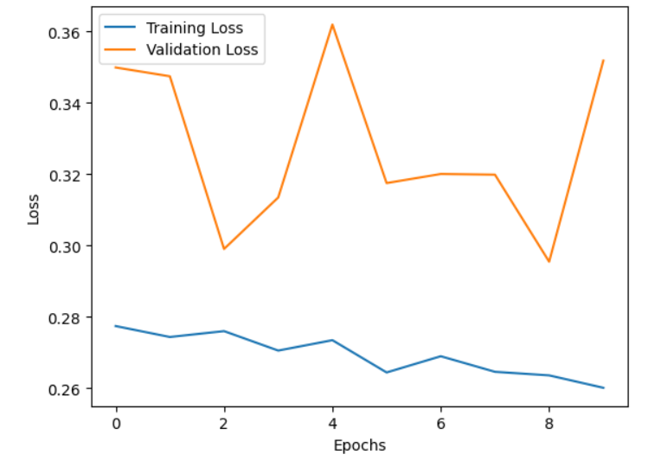
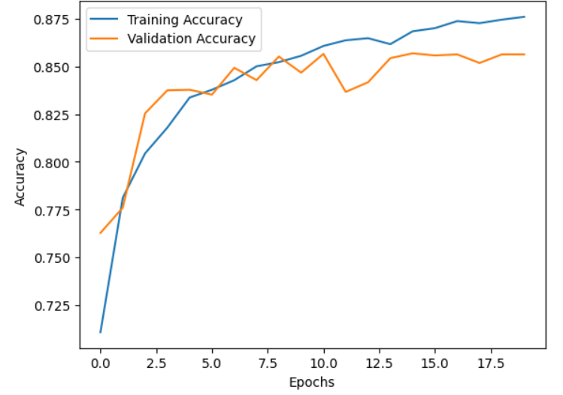
Analysis

Slide 12
Conclusions and Discussion
1. Key Findings:
CNN: Best performance, ideal for complex image data.
Logistic Regression: Moderate accuracy, struggles with high-dimensional data.
Decision Tree: Prone to overfitting, good training accuracy but lower test accuracy.
2. Model Comparisons:
Strengths: CNN excels in image analysis; Logistic Regression and Decision Trees are faster and less resource-intensive.
Weaknesses: Logistic Regression and Decision Trees lose critical information when flattening images.
3. Limitations:
Loss of spatial data with Logistic Regression and Decision Trees.
Overfitting in Decision Trees indicates the need for better pruning or regularization.
4. Future Directions:
Explore dimensionality reduction for Logistic Regression and Decision Trees (PCA or t-SNE )
Implement ensemble methods to combine model strengths.
Increase dataset size and diversify CNN training data.

Slide 13
References
ELKarazle, K., Raman, V., Then, P. (2022). Facial Gender Classification Using Deep Learning. In: , et al. Proceedings of the 13th International Conference on Soft Computing and Pattern Recognition (SoCPaR 2021). SoCPaR 2021. Lecture Notes in Networks and Systems, vol 417. Springer, Cham.
Sajja, T.K., Kalluri, H.K. “Gender classification based on face images of local binary pattern using support vector machine and back propagation neural networks.” Adv. Modell. Anal.
(2008, June). The Application of Decision Tree in Gender Classification. Paper presented at the Congress on Image and Signal Processing (CISP '08), Volume 4.

Slide 14
Thank You !

